Slide 1
Polynomial Regression – When Linear Fails
Basic Machine Learning (CSST 102)
Laguna State Polytechnic University
1st Semester, Academic Year 2025–2026
Kean Gabriel E. Salvahan

Slide 2
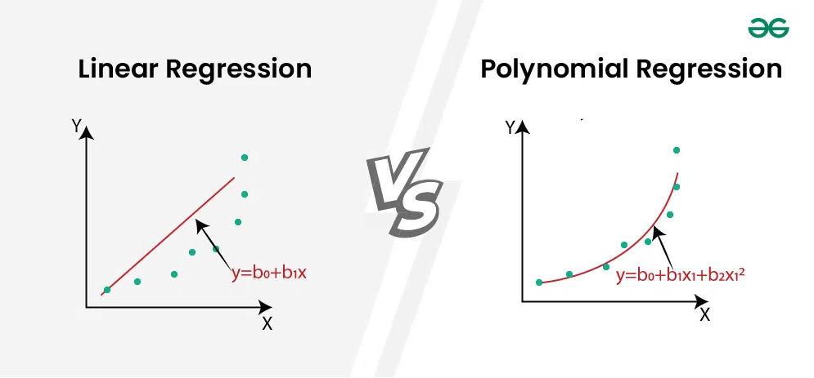
Introduction & The Problem with Straight Lines
Image Source: www.geeksforgeeks.org

Slide 3
What is Polynomial Regression?
Input: x
Feature Transformer (Polynomial Terms)
x
x²
Linear Regression Model (w₀, w₁, w₂)
Output: y = w₀ + w₁x + w₂x²

Slide 4
Real-World Applications
🌍↗️
Population Growth
🦠⏳
Epidemic Curve
🌡️📈
Climate Data
All show non-linear trends — perfect for Polynomial Regression.

Slide 5
Recent Trends
Polynomial Regression Model to Predict Future COVID-19 Cases
Authors: Dr. S. Suriya & R. Sanjay Krishna (PSG College of Technology, India)
Published: Journal of Artificial Intelligence and Capsule Networks, June 2023
Objective:
Develop a polynomial regression model to forecast short- to medium-term COVID-19 cases in India using historical data and key influencing factors (e.g., population density, healthcare access, government policies).
Method:
Used real-world case data from Our World in Data
Applied polynomial regression (degree optimized to avoid overfitting)
Validated with manual calculations and Python (Pandas, Scikit-learn)
Key Results:
96.64% prediction accuracy for both 5-day and 30-day forecasts
Correctly identified a recent case surge as a temporary spike, not a new wave
Model effectively captured non-linear trends in case data

Slide 6
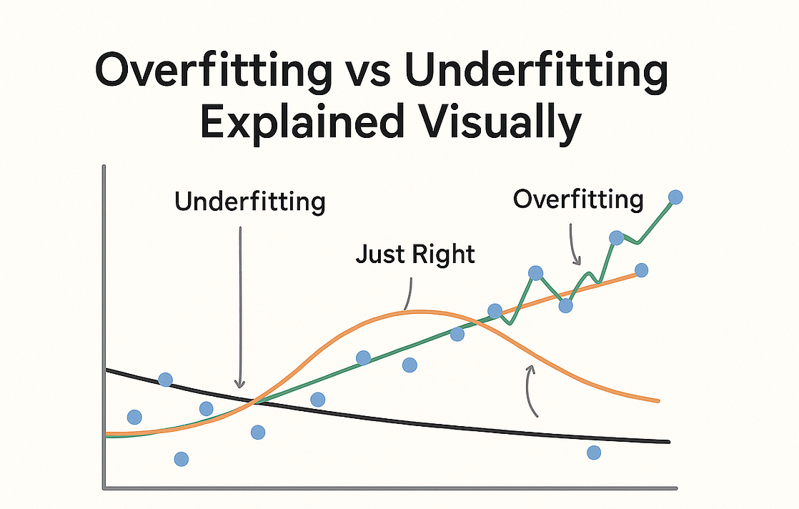
A Word of Caution
Image Source: https://pub.towardsai.net/what-is-overfitting-in-machine-learning-ebdf40bb21b1
Underfitting
Just Right
Overfitting

Slide 7
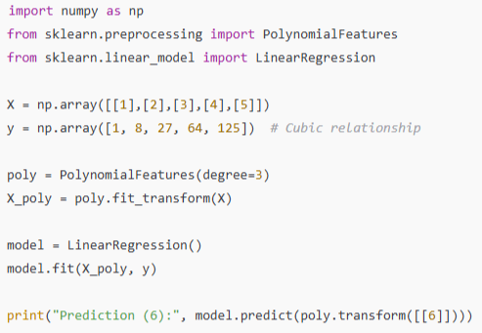
Implementation in Python (Scikit-Learn)

Slide 8
References
Géron, A. (2022). Hands-On Machine Learning with Scikit-Learn, Keras, and TensorFlow (3rd ed.). O'Reilly Media.
Filipow, N. (2023). Exploring flexible polynomial regression as a method to investigate the effects of exercise on health. Journal of Health Analytics.
Lyu, B. (2024). Multiple-model polynomial regression and efficient algorithms for data analysis. IEEE Transactions on Pattern Analysis and Machine Intelligence.
Hey Amit. (2024). Polynomial Regression for Prediction. Medium.

Slide 9
Thank you!
Questions?

